Slide 1
CIS 6375 Distributed Systems Security Fall 2018
Dr. Eduardo B. Fernandez
Dept. of Computer Science and Eng.
Florida Atlantic University
http://faculty.eng.fau.edu/fernande/
fernande@fau.edu
Notes:
Dr. Fernandez is a Professor of Computer Science and Engineering at Florida Atlantic University, Boca Raton, FL.
He has a MSEE from Purdue University and a Ph.D. in Computer Science from UCLA.
He is the author of one of the first books published on database security and has written numerous papers on different aspects of security. He has also published a good number of papers on object-oriented design and fault-tolerant systems.
He has been a consultant for many companies, including IBM, Siemens, Harris, Motorola, and others.

Slide 2
The value of information
We depend heavily on computers; most of the devices that make our life safe and convenient, e.g. cell phones, vehicle controls, and building controls, use some type of software to store and process information
We also rely on institutions, public or private; we are born in hospitals, then go to schools, join clubs, get jobs in the government or private businesses, get married at some church or public office, travel using some agency, etc. All these institutions use computers to keep information about us.
In general, the data of an institution has great value; it may represent customers, orders, bills, business plans, course grades, etc.
Data corruption in a hospital may result in patients getting the wrong medication, leakage of military information could endanger an army in war, and erroneous aircraft maintenance information could compromise passenger safety, unauthorized access to a bank information may result in large money losses.

Slide 3
Motivation for security
Data and other resources are assets, items that have value for us; security is the protection of these assets, including enterprise and individual information.
We need this protection because there are people who intentionally try to access or modify information either for their own gain, for political purposes, or for the sake of disruption
In addition to the direct monetary cost there may be losses of productivity, and even endangering of lives

Slide 4
Do we have a problem?
Almost every week we have a major security incident.
Companies: Target, Sony (twice), Home Depot, Goodwill, JP Morgan, Chick-fil-A, Neiman Marcus, Michaels, Yahoo (twice), Equifax, Uber,…
Government: IRS, DOE, OPM,…
Physical systems: German steel mill, Stuxnet (Iran), Aramco,…
Medical systems and devices: several, e.g. Anthem
Point of sale: Target, Michaels, Home Depot, …

Slide 5
Some recent attacks
Steel Plant in Germany 2014— destruction of an oven in 2014
Sony 2014: The data included personal information about employees and their families, e-mails between employees, salaries, copies of then-unreleased Sony films, …[
Anthem 2015: 80 million records were hacked, the compromised information contained names, birthdays, medical info., IDs, SSNs, addresses, e-mail addresses and employment information, including income data.
SWIFT attack in Bangladesh: $81 M
Yahoo 2016---reduced its value by $350 M
Equifax 2017—143 millions of personal records
Uber 2017—57 millions of accounts of drivers and riders

Slide 6
Hackers’ $81 Million Sneak Attack on World Banking http://www.nytimes.com/2016/05/01/business/dealbook/hackers-81-million-sneak-attack-on-world-banking.html
Swift — the Society for Worldwide Interbank Financial Telecommunication — is billed as a supersecure system that banks use to authorize payments from one account to another.
But last week, for the first time since hackers captured $81 million from Bangladesh’s central bank in February, Swift acknowledged that the thieves have tried to carry out similar heists at other banks on its network by sneaking into the beating heart of the global banking system.
The admission that the attack was not a one-time event in a developing country but perhaps part of a broader threat has thrust Swift into a spotlight, raising questions about how securely money is being moved around the world. Some financial security experts point out the Swift system is only as safe as its weakest link.

Slide 7
Costs of a data breach
An attack on Google cost that company about $500,000 in 2005.
Cost of Data Breach Study: Done by Ponemon Institute, sponsored by IBM, June 2018
According to them, the average total cost of a data breach was $3.86 million. The average cost for each lost or stolen record containing sensitive and confidential information was $148 in this year’s study.
Average cost savings with an Incident Response team: $14 per record

Slide 8
The Nature of Software...
Software is intangible
Hard to understand development effort
Software is easy to reproduce
Cost is in its development
in other engineering products, manufacturing is the costly stage
The industry is labor-intensive
Hard to automate

Slide 9
The Nature of Software ...
Untrained people can hack something together
There are many kits to build apps with little knowledge
One-week coding courses are common
Quality problems are hard to notice
Software is easy to modify
People make changes without fully understanding them
Software does not ‘wear out’
It deteriorates (erodes) by having its design changed:
erroneously, or
in ways that were not anticipated, thus making it more complex or less secure

Slide 10
The Nature of Software
Conclusions
Much software has poor design and is getting worse
Demand for software is high and rising
Software complexity is increasing
We are in a perpetual ‘software crisis’
We have to learn to ‘engineer’ software
An important aspect to engineer is security

Slide 11
Software complexity
Embedded systems
The average device now has one million lines of code, and that number is doubling every two years.
Aerospace
A modern passenger jet, such as a Boeing 777, uses about 4 million lines of code. Older planes such as a Boeing 747 had only 400,000 lines of code.
A car uses 30-50 electronic control units (ECUs) that altogether include as much as 100 M lines of code.

Slide 12
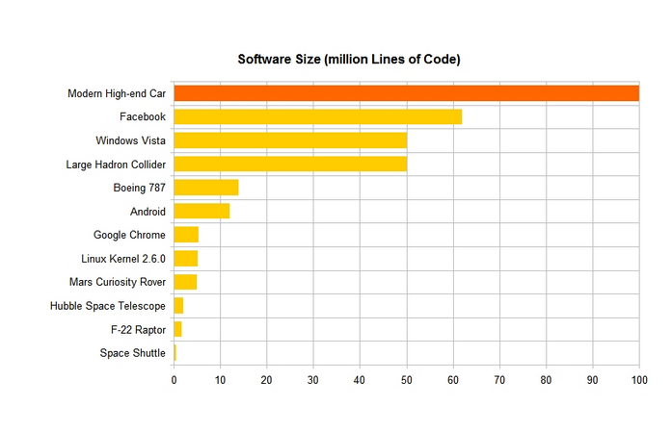
Code size https://www.linkedin.com/pulse/20140626152045-3625632-car-software-100m-lines-of-code-and-counting

Slide 13
Course objectives
Analyze current topics on distributed system security, including new architectures.
Understand the modus operandi of attacks to distributed systems and their countermeasures.
Understand the importance of system architecture on security
Practice the use patterns and appropriate methodologies to build secure systems
Practice how to write papers and reports

Slide 14
General approach
Emphasis on analysis to understand the complete picture, look at a combination of specific components—architectural view—and see the resultant effect on security
Synthesis: what should we add or change in a system to get a given degree of security; how to build secure systems.
Critical thinking, no blind application of rules
Design-oriented problems do not have algorithmic or unique solutions

Slide 15
A similar opinion
The mantra of any good security engineer is: “Security is not a product, but a process.
It's more than designing strong cryptography into a system; it's designing the entire
system such that all security measures, including cryptography, work together. “
– Bruce Schneier

Slide 16
About me
Eduardo B. Fernandez (Eduardo Fernandez Buglioni)
Professor of Computer Science at Florida Atlantic University, Boca Raton, FL., USA
Worked at IBM for 8 years (L.A. Scientific Center).
Wrote the first book on database security (Addison-Wesley, 1981) and two books on security patterns (2006 and 2013)
Author of many research papers, (Google Scholar h-index 38, i10index 140, 7965 citations)
Consultant to IBM, Siemens, Lucent, Motorola, Huawei,…

Slide 17
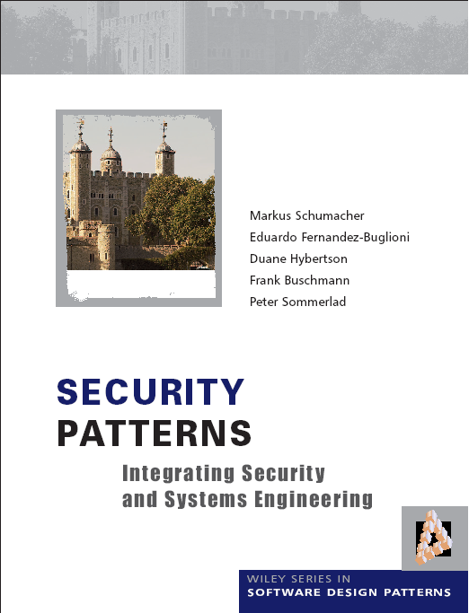

Slide 19
American-Chilean-Italian-Chinese family
Born in Chile, have dual citizenship US and Chile
My mother was Italian, my father’s family was from Spain
I have lived in the US since 1973
My wife is Chinese (from Shanghai)
My two daughters (20 and 27)were born in the US and also have US and Chilean nationality
I have traveled the world: Mexico, Australia, France, China, Japan, Germany, South Africa, Morocco, …
Good chess player (candidate master) and reader of good literature

Slide 20
First discussion board in Canvas
Introduce yourself in similar style
Indicate also what aspect of security are you most interested

Slide 21
Travel during the semester
Because of my research activities I must travel
A professor who does not do research or consulting cannot be effective to teach modern technologies which change constantly
My absences: two classes in August (next week), one class in November
My PhD students Madiha Haider and Virginia Romero will replace me during the times I travel or I will record the class

Slide 22
Travels
China (July16-August 16)—Several cities, gave talks at Beijing University, Guangzhou University, Hong Kong Polytechnic University, and Huawei Research Center
Hamburg, Germany (August 25-Sept. 02)—13th Int. Conference on Availability, Reliability, and Security (ARES)—Present two papers
Valparaiso, Chile (November 18-25)—Latin American Pattern Languages of Programs Conference, Valparaiso, Chile—Present three papers
Tokyo, Japan (December 2-15)—National Institute of Informatics (NII). Work on research.

Slide 23
Course details I
Prerequisites: An introductory course on Computer Security. Background on web-based systems. Basic knowledge of UML.
Textbooks: Set of slides, posted on Canvas
E.B.Fernandez, “Security patterns in practice: Building secure architectures using software patterns”, Wiley Series on Software Design Patterns, 2013. Parts posted on Canvas.
E.B.Fernandez, The Design and Evaluation of Secure Systems (class notes for CIS6370)-- Provides background on security
See security textbooks at the end of the chapter

Slide 24
Course details II
E-mail: fernande@fau.edu
Web page: http://faculty.eng.fau.edu/fernande/
Telephone: +1-561-843-4352 (only for emergencies)
Grading: Homework assignments (2) 30%
Research Project 70%
Relative grading, no curves or ranges.
Projects can be selected from a list to be provided or you can propose your own (to be approved by me)

Slide 25
Typical assignment questions
How would a cloud SRA improve a secure system development methodology such as ASE or similar? Be as precise as possible, showing what effect the SRA would have in each stage of the life cycle and justify your decisions. Would appropriate SRAs be useful for systems that do not use clouds (justify your answer with an example)?
"Describe using a sequence diagram a specific type of attack. Indicate how you would stop this attack“
"Find five threats for drones and indicate possible defenses"

Slide 26
Course objectives
Analyze current topics on distributed system security, including new architectures.
Understand the modus operandi of attacks to distributed systems and their countermeasures.
Understand the importance and effect of system architecture on security
Practice the use of patterns and apply a methodology to build secure systems
Learn how to write papers, reports, and theses

Slide 27
Outline
1. Motivation and overview. Distributed systems and security. Threats.
Review of basic aspects of security.
2. Security patterns. Other types of patterns. Reference architectures.
Review of UML. Security principles: sandboxing, isolation methods.
3. Threat analysis. Misuse patterns. Defenses. Authentication: OAuth,
Shibboleth. Authorization: PEP and PDP. Active defenses. AI and attack
detection.
4. Methodologies for building secure distributed applications. Secure
Solution Frames. ASE. UMLSec, SecUML, Secure Tropos.
5. Security evaluation. Use of patterns and arguments. Common Criteria.
Evaluation, certification and attestation.
6 Distributed architectures. Secure versions of patterns: Broker, MVC,
Publish/Subscribe. Agents. P2P systems. Middleware. Assignment 1
7. SOA and Web services: architectures, attacks, and standards. Web
services patterns. Identity. Security standards: SAML, XACML. Misuse
patterns. REST security. Cloud ecosystems

Slide 28
Outline II
8. Security in cloud computing. Threats and defenses. Patterns and
misuse patterns. Access Control, Infrastructure security. OpenStack
security. Container security. Virtualization security. NFV. Cloud ecosystems.
9. New defenses. Analytics and AI to detect attacks. Deception-based
defenses. Adaptive defenses. SIEM.
10. Cyber-physical systems. Threat modeling. Stuxnet. Security in smart
grid, vehicles, cargo ports, oil and gas pipelines, smart buildings. The
Internet of Things. Fog computing. Robotics. Assignment 2.
11. Wireless systems. Operating system architectures, application security.
Sensor network security. Wireless clouds. Vehicular network threats and
defenses.
12. Specialized architectures. Security in Blockchain architectures. Secure
Big Data architectures. Attacks to AI-based systems.
13.Secure software development for clouds and IoT. DevOps, SecOps,
secure microservices.

Slide 29
Approaches to security
Formal Models and cryptography
Theoretical
Analysis of
Security
Verification
UML/OCL models
Security patterns
Certification
Model-driven
Security
Vulnerability analysis
Code examination
Code-based
Security
Certification

Slide 30
Approaches to security
Theoretical models using model checking do not prove security because they make many assumptions which may not be true in practice. Limited in size.
Cryptographic methods are effective but only for specific aspects: system or message authentication, secure transmission of messages, storage protection. They cannot stop attacks based on code or architecture flaws.
Code-based methods cannot find all vulnerabilities and many attacks exploit system interactions, not code flaws.
Model-based (architecture-based) security builds a strong structure where parts of the system may be compromised but the essential parts of the system can be protected.
Combinations are possible for higher security

Slide 31
Need for a holistic view
Need for a holistic view, not disjoint pieces. Disjoint mechanisms cannot prevent threat that are combinations of legal actions
Security should be based on institution policies
Methods based on local system protection, e.g., cryptography, are very important to enforce the high-level restrictions but are not enough to provide whole system security.
Code-based security is incomplete, most systems now are distributed, security is a systems problem
Notes:
Without institution policies security is hopeless. In that case security will become a series of patches and isolated measures with enormous holes in between.
This is the case of many places now.

Slide 32
The security problem
Unauthorized data disclosure (confidentiality or secrecy).
Unauthorized data modification (integrity). May result in inconsistencies or erroneous data. Data destruction may bring all kinds of losses.
Denial of service—Users or other systems may prevent the legitimate users from using their system. Denial of service is an attack on the availability of the system.
Lack of accountability—Users should be responsible for their actions and should not be able to deny what they have done (non-repudiation).

Slide 33
Attacks and defenses
The generic attacks are realized in two basic ways: by direct attacks from a person trying to exploit a vulnerability or flaw in the system, or using malware, software that contains code that exploits one or more of these flaws
Security defenses may operate in one or more of three modes and we need to combine them:
Prevent or mitigate an attack. Prevention means completely stopping the attack while mitigation implies partial defense or reducing its effects
If we cannot stop or mitigate the attack, at least we should be able to know that an attack is happening, i.e., we should detect the attack. Detection is also useful to stop an attack because it can alert other mechanisms to take action
After the attack has happened we need to have ways to recover from its effects and analyze it so we can improve the system

Slide 34
Countermeasures (defenses)
Identification and Authentication (I&A)—Identification is a user or system action where the user provides an identity. Authentication implies some proof that a user or system is the one he/it claims to be. The result of authentication may be a set of credentials, which later can be used to prove identity and may describe some attributes of the authenticated entity (See Chapter 4 in notes).
Authorization and Access control (A & A)—Authorization defines permitted access to resources depending on the accessor (user, executing process), the resource being accessed, and the intended use of the resource. Access control requires some mechanism to enforce authorization (See Chapter 2 in notes).
Logging and Auditing (L&A)—Implies keeping a log of actions that may be relevant for security. These functions can be used to collect evidence for prosecution (forensics) and to improve the system by analyzing why the attack succeeded.
Hiding of information—It is usually performed by the use of cryptography but steganography is another option.The idea is to hide the information in order to protect it. ( Chapter 3).
Intrusion detection—Intrusion Detection Systems (IDS) alert the system when an intruder is trying to attack the system (Chapter 7).

Slide 35
Distributed systems
A distributed system contains autonomous computational units that interact (interoperate) with each other through messages and are connected through some type of network.
Why are distributed systems important? Most practical information and control systems are distributed systems. Examples: the Internet, intranets in companies, wireless networks, aircraft control systems, distributed databases, and distributed file servers

Slide 36
Reasons for distributed systems
Reduced costs--resource sharing is possible and this decreases installation cost
Availability—failures are not catastrophic due to the inherent redundancy
Inherent distribution of some applications—we need to handle physically distributed actions
Performance—we can improve the performance of algorithm execution by adding the computational power of many systems
Extensibility—it is easier to add more units, more devices, new software.
Collaboration and communication—allow users to work together and exchange information.
Security--More vulnerable to attacks but distribution can be used as a defense

Slide 37
Architectures
The architecture of a system defines the system in terms of components (units) and of interactions between these units. Architecture includes: system topology and organization, decomposition into components, assignment of functionality to components, component interactions, system properties (nonfunctional requirements, e.g. performance, security), correspondence between requirements and units.
The architecture of a system is a basic determinant of its security; code flaws can be corrected or patched, architectural deficiencies cannot.

Slide 38
Threats
Definitions
Types of misuse
Internet vulnerabilities
Attacks

Slide 39
Securing systems
We need to understand the threats to the system to decide how to defend it
Excess of security mechanisms results in loss of performance, extra complexity, and higher costs
The objective is to provide an appropriate defense according to the value of our assets

Slide 40
Types of Threats
Direct attacks to the operating system
Direct attacks to the database system
Directs attacks to the application
Denial of service
Almost no attacks to the messages in the network
Malware: Trojan horses, viruses, worms
Repudiation

Slide 41
Definitions
A vulnerability is a situation or state that may be exploited by an attack (a code flaw, an unprotected port,…)
A threat is a potential attack
An attack is an attempt to misuse the system (violate confidentiality or integrity,…)
A defense (safeguard, countermeasure) is a way to block or mitigate (reduce) an attack
A misuse is a violation of some security property

Slide 42
Types of misuse
The outcome of misuse can be loss of confidentiality or integrity, theft of services, denial of service, defamation,…
An attack has a perpetrator, who has a motivation. The attack has a method of operation (modus operandi) to accomplish a mission with respect to a target (victim). The damage of a mission can be loss of assets, money, lives

Slide 43
Attackers
Insiders -- According to studies about half of the attacks to a system come from insiders [Neu99]. I think he means successful attacks.
Hackers -- Usually try to show off their ability by penetrating systems
Spies -- Industrial or government spionage
Organized crime—a large number of attacks with purposes of lucre, mostly confidentiality attacks
Terrorists and state forces—attacks to infrastructure systems, with purposes of disruption and destruction

Slide 44
Attack methods
Preparation—Information gathering, scanning, planting malicious code, masquerading (spoofing)
Activation—perpetrator-controlled, timed, victim activated
Mission—active (affects integrity and availability), and passive misuse (eavesdropping, inference), denial of service

Slide 45
Attack stages
<<actor>>
:Attacker
target1:
:Data
target2:
prepare Attack
activate Attack
read
modify/destroy
propagate

Slide 47
OO and UML
UML is an object-oriented language for specifying, constructing, visualizing, and documenting a software design.
Basically a notation and its corresponding meaning, not a process.
Object Management Group (OMG) standard (www.omg.org)
We will use it to describe systems
A summary is in Canvas

Slide 48
ADLs
Architecture Description Languages (ADLs) have been used to describe architectures.
ADLs combine a formal language with tools to support the construction and analysis of software systems.
We use UML as ADL. UML cannot describe well all necessary aspects but it is sufficient for most purposes and can be extended if necessary.
We can use UML-derived languages to improve some aspects: SysML, SoaML, SysADL

Slide 49
Policies
Institution policies
Security policies
Example

Slide 50
Need for policies
The policies of an institution define its way of accomplishing its objectives
Security policies define its way to protect its information
Without policies we don’t know what we should protect
Policies are realized by security mechanisms (possibly described as patterns)

Slide 51
Institution policies I
Laws, rules, and practices that regulate how an institution manages and protects resources. Another definition is: high-level guidelines concerning information security. Computer mechanisms should enforce these policies.

Slide 52
Some security policies
Open/closed systems--In a closed system everything is forbidden unless explicitly allowed, forgetting a rule may bring annoyance but no security problems
Need-to-know (Least privilege)-- Give enough rights to perform duties, many attacks happen because users have too much access
Granularity– amount of information to control: a whole file, a data item

Slide 53
Security policies II
Obligation—What has to be done before or after accessing data
Separation of duty—Separate critical functions into parts to be done by different people or systems. Requires collusion for illegal actions
Content-dependent access control—Access decision are based on the values of the data. I can see my own information but not others’.
Authenticate all transactions—needed for accountability and access control

Slide 54
Security policies III
Centralized/decentralized control-- In a decentralized system its units or divisions have their own administrators and authority to define their own policies or enforcement mechanisms as far as they don’t violate global policies.
Ownership and administration-- In many systems the user that creates some data becomes its owner and has all the rights on it. An administrative policy separates the administration of the data from its use. Ownership may violate separation of duty in that the user of information is also its administrator, which for institution data is a conflict of interest but it is acceptable for personal files.

Slide 55
Use of policies
Secure systems must be closed but sometimes open access to information is more important, e.g., libraries, data warehouses, …
The need-to-know principle must be applied with an appropriate granularity, many attacks happen because of too many rights
Policies should be defined using some governance strategy at the institution level, not left to system administrators

Slide 56
Example of university policies
An instructor can look at all the information about the course he is teaching.
An instructor can change the grades of the students in the course he is teaching
A student may look at her grades in a course she is taking
The department head can add/delete course offerings
The registrar can add/delete students from course offerings
Faculty members can look at information about themselves

Slide 57
Applying security policies to stop threats Example: a financial institution
Consider a financial company that provides investment services to its customers.
Customers can open and close accounts in person or through the Internet.
Customers who hold accounts can send orders to the company for buying or selling commodities (stocks, bonds, real estate, art, etc.).
Each customer account is in the charge of a custodian (a broker), who carries out the orders of the customers.
Customers send orders to their brokers by email or by phone.
A government auditor visits periodically to check for application of laws and regulations.
The Figure shows the Use Case diagram for this institution.

Slide 58
A financial institution

Slide 59
From threats to policies
A systematic way to identify system threats, and determining policies to stop and/or mitigate their effects
Analysis of the flow of events in a use case or a group of use cases, in which each activity is analyzed to uncover related threats. This analysis should be performed for all the system uses cases
Then we select appropriate security policies which can stop and/or mitigate the identified threats.

Slide 60
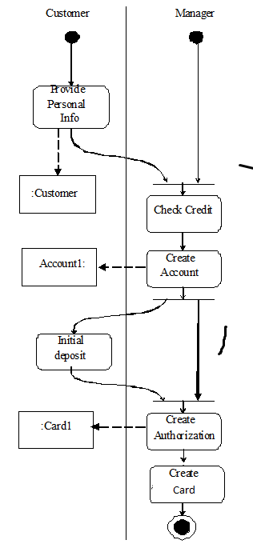

Slide 61
Threats for this use case
Use Cases 1 and 2: Customer is an impostor. Possible confidentiality and integrity violations.
Manager impersonation. Can capture customer information. Confidentiality attack.
Use Cases 3 and 4. Broker impersonation. Possible confidentiality violation.
Customer can deny giving a trade order. Repudiation. Customer impersonation. Confidentiality or integrity attacks.
Stockbroker embezzling customer’s money.
Use Case 5. Impersonation of auditor. Confidentiality violation.

Slide 63
Threats
T1.The customer is an impostor and opens an account in the name of another person
T2.The customer provides false information and opens an spurious account
T3.The manager is an impostor and collects data illegally
T4.The manager collects customer information to use illegally
T5.The manager creates a spurious account with the customer’s information
T6.The manager creates a spurious authorization card to access the account
T7.An attacker tries to prevent the customers to access their accounts
T8.An attacker tries to move money from an account to her own account

Slide 64
Use case analysis leads to policies
T1. T3. Mutual authentication. Every interaction across system nodes is authenticated.
T2. Verify source of information.
T4. Logging. Since the manager is using his legitimate rights we can only log his actions for auditing at a later time.
T5. T6. Separation of administration from use of data. For example, a manager can create accounts but should have no rights to withdraw or deposit in the account.
T7. Protection against denial of service. We need some redundancy in the system to increase its availability.
T8. Authorization. If the user is not explicitly authorized he should not be able to move money from any account.
Policies can be realized with patterns

Slide 65
Systematic mapping of threats to policies

Slide 66
Threat enumeration

Slide 67
Security Textbooks
[And08] R. Anderson, Security Engineering (2nd. Ed.), Wiley, 2008.
[Bis03] M. Bishop, Computer Security: Art and science, Addison-Wesley 2003.
[Gol11] D. Gollmann, Computer security (3nd Ed.), Wiley, 2011.
[Pfl15] C.P.Pfleeger, S.L. Pfleeger, J. Margulies, Security in computing, 5th Ed., Pierson, 2014.
[Stal18] W. Stallings and L. Brown, Computer security: Principles and practice (4th. Ed.), Prentice Hall 2018.

Slide 68
Pattern books
[Bus96] F. Buschmann, R. Meunier, H. Rohnert, P. Sommerland, and M. Stal., Pattern- oriented software architecture, Wiley 1996.
[Fer13] E.B.Fernandez, “Security patterns in practice: Building secure architectures using software patterns”, Wiley Series on Software Design Patterns, 2013.
[Gam94] E. Gamma, R. Helm, R. Johnson, J. Vlissides. Design Patterns: Elements of Reusable Object-Oriented Software, Addison-Wesley, Boston, Mass., 1994
[Sch06] M. Schumacher, E. B.Fernandez, D. Hybertson, F. Buschmann, and P. Sommerlad, Security Patterns: Integrating Security and Systems Engineering", Wiley Series on Software Design Patterns, 2006.

